Slide 1
Product Engineering Solutions IT Overview
We make it easier and faster for Intel to deliver amazing products
October 2017
Notes:
New “vision”

Slide 2
About Product Engineering Solutions IT (PES IT)
What we do
How we will succeed
How you can get engaged
What’s most important right now
How we behave
Why we exist
Where we are
Notes:
Used Patrick Lencioni book “The Advantage” to guide our conversations. The overview in this deck is the outcome from the 6 Questions in Creating Clarity
Why do we exist?
Who we are ( this is our own addition, not one of the 6 questions)
How do we behave?
IT cultural values … & op model … and this is what it means to us.
"innovative, fast-paced, perpetual learners“
What do we do?
How will we succeed?
What’s most important, right now?
Who must do what?

Slide 3
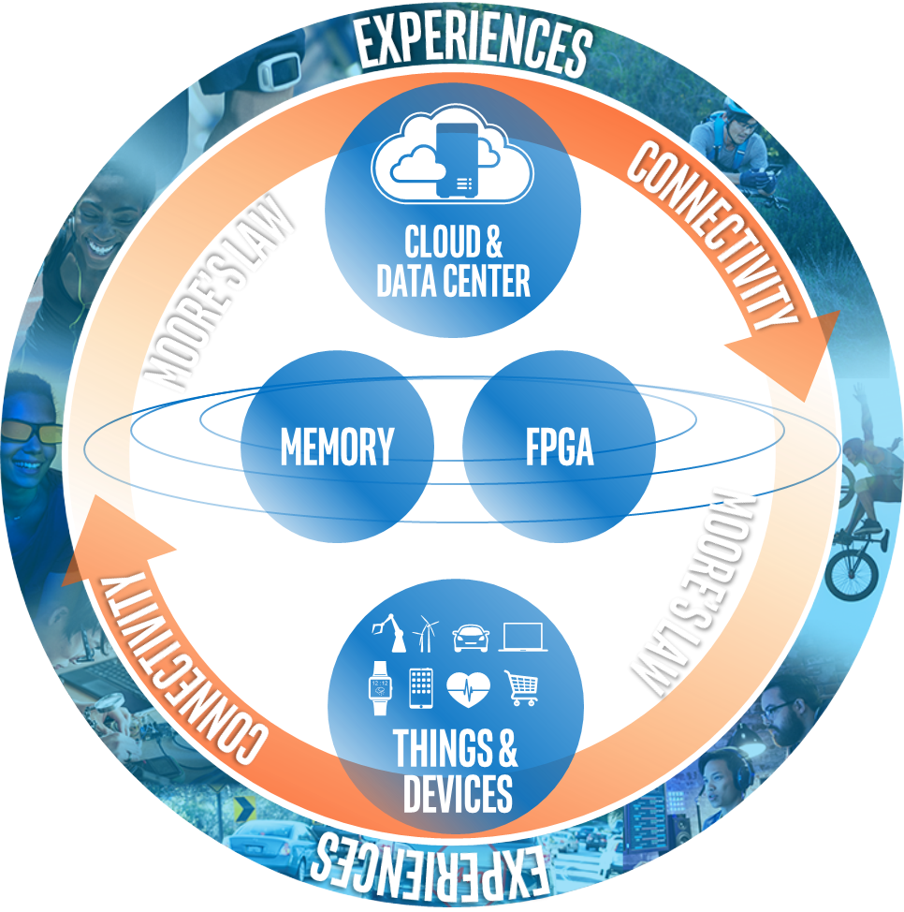
Why we exist
We make it easier and faster for Intel to deliver amazing products
Notes:
Why do we exist? The answer to this question will yield a core purpose, or the fundamental reason the company is in business

Slide 4

Welcome new teams!
Data Technology Group (DTG) delivers mission-critical data management platform and workflow solutions to accelerate product development and execution for PEG and its partners. DTG solutions, such as HSD-ES, CSS, and DSS, span Intel’s product development lifecycle from architecture to design to validation. These solutions are used by more than 35K engineers and developers across Intel.
Corporate Quality Network IT (CQN IT) delivers all automation capabilities for Intel’s Corporate Quality organization. CQN IT solutions increase product data quality, lab throughput time, engineering efficiency, product qualification, and critical path support of Intel’s sample and product processing. The team manages over 70 solutions across 10 capability groups and all Intel geographies. CQN IT is the automation team for everything that drives qualification and defect reduction in CQN.

Slide 5
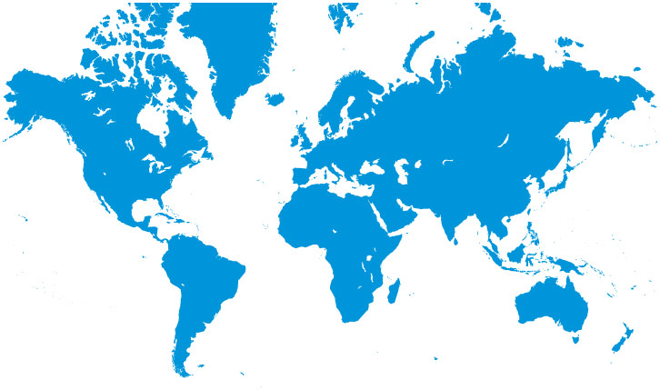
Where we are
Our People
631 employees + 80 students & ICE
PES IT: 559+63
DTG : 41+5
CQN IT: 31+12
9 countries and 16 sites
Over 50% are software engineers or developers
OR: 88+1
CA: 3+1
OR: 22
UK/IR: 9
OR: 5
BJ: 31+7
AZ: 53+1
IS: 46+21
SH: 62+19
SC/SJ/SD: 59
AZ: 9
IS: 4+4
FM: 23+1
CR: 23+6
PG: 116+5
BA: 46+1
PG: 10+1
FM: 5
CR: 17+12
Existing PES IT
New to PES IT
Data Technology Group (DTG)
Corporate Quality Network IT (CQN IT)
Notes:
Need to update and include the embedded teams.

Slide 6

Get to know the PES IT site leaders
Where we are
Site | Staff Sponsor | Site Rep
Arizona | Eberts, Kirt | Melow, Annie
Costa Rica | Agarwal, Ashok | Rana, Sanjeev
Folsom | Agarwal, Ashok | Patterson, Doug
India | Agarwal, Ashok | Ramachandra, Satish
Ireland | Gans, Greg | Voorakkara, Sridhar
Israel | Eberts, Kirt | Baruch, Shirly
Malaysia | Eberts, Kirt | Tan, Hooi Min
Oregon | Gans, Greg | Daim, Yonca
Santa Clara/San Jose | Thadani, Ravi | Innecco, Carlos
Shanghai/Beijing | Gans, Greg | Jia, Jessie C
Current list: https://sp2010.amr.ith.intel.com/sites/PDIT/Lists/Site%20Sponsors%20and%20Reps/AllItems.aspx

Slide 7
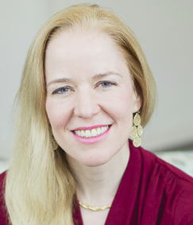
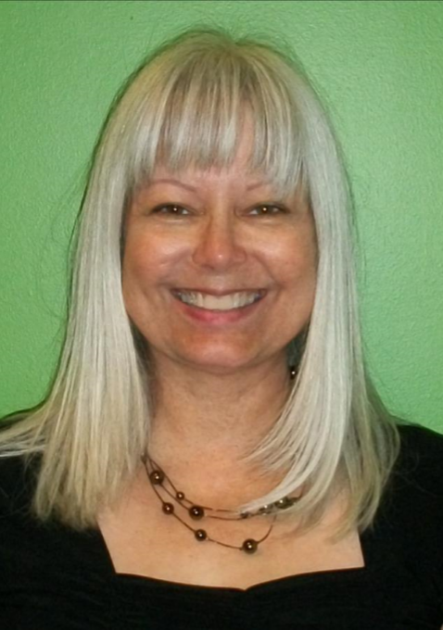
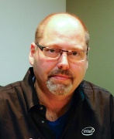




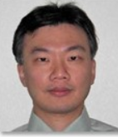


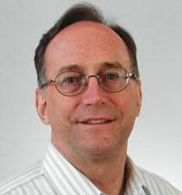
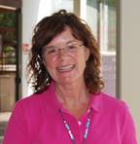
Get to know PES IT org leaders
Mandy Mock (OR)
Vice President & General Manager, PES IT
Susie Morris (OR)
Sr. Administrative Assistant
Greg Gans (OR)
IT Professional Technical
Services (IT PTS)
Ashok Agarwal (SC)
Product Lifecycle Solutions
(PLCS)
Kirt Eberts (AZ)
Product Data Solutions
(PDS)
Mary Rossell (FM)
Privacy Office
Ravi Thadani (SC)
Programmable Solutions
Group IT (PSG IT)
Phillip Young (OR)
Data Technology Group (DTG)
Spencer Lamoreaux (AZ) Corporate Quality Network IT (CQN IT)
Ronan Duffy (AZ)
Chief of Staff and
Business Operations
Mark Bernhard (OR)
Operational Excellence
Gail Jones (FM)
Communications and
Employee Engagement
Design Acceleration – Aqil Abbasi (FM) | Finance - Todd Schwendinger (AZ) | Human Resources – Gina Gutierrez (NM)
October 2017

Slide 8
How we behave: IT Cultural Attributes
These are the core values that we embrace as an IT team. For more details, visit One IT on Inside Blue
One Intel/
One IT
Collaborate across Intel and IT to accelerate Intel’s strategic direction
Customer
at the Center
Delivering innovative and competitive solutions that anticipate and exceed the needs of our customers
Possibility
Thinking
A “nothing is impossible” way of thinking that delivers breakthrough results
Agility
Experiment, continuously improve and operate
with velocity
Adaptability
Be open, inclusive, and embrace change in pursuit of excellence
Notes:
How do we behave? The answer to this question is embodied in an organization’s core values, which should provide the ultimate guide for employee behavior at all levels.
Aspirational – how you think you SHOULD behave
Accidental – oops, we just hired a bunch of like-minded people by accident.
Permission-to-Play – honesty, integrity, etc. If you must ask, don’t apply.
Core – focus here. This is what differentiates you.
Inherent and natural
In place for a long time
Fast paced, Innovative, Learning focused, passion for product ---

Slide 9
What we do
We make it easier and faster for Intel to deliver amazing products
Improve quality and accelerate product time to market through solutions that connect product data from ideation to retirement
Accelerate product development and innovation through “burst capacity” resources on demand
Built in privacy: Keep the trust as Intel shifts to new data intensive markets
Landing zone for engineering focused mergers and acquisitions
We align with and support IT Strategy
Notes:
What do we do? The answer to this question is the simplest of the six; it’s a description of what the organization actually does.
Clarify that ideation to retirement goes through (includes) manufacturing

Slide 10
How we will succeed – our three strategic focus areas
Strategic partner to product groups in accelerating product development, improving product cost, and schedule predictability
Best-in-class innovation and OpX
Skilled and adaptable workforce with engaged and inspired employees
1
2
3
Notes:
How will we succeed? This question requires the team members to develop a strategy, i.e., how to make decisions in a purposeful, intentional, and unique way to in order to maximize success (and differentiate from competitors).
Win/Win partnerships with BUs and IT
Joint investment decisions
Multi-Year planning ( CISA, SC 2027)
Dynamic prioritization and project governance based on clearly articulated value
Explicitly ZBB lower priority work
Breakdown silos across lifecycle in product groups
Drive OpX with passion, vigor and discipline
Landscape simplification (tools and data)
DevOps & ITIL maturity – Make all the work visible to reduce hardship & drudgery
Winning and energized team
Skill and career development aligned to TOP model
Empowerment
2020 WFP (Workforce plan) – future skills & landscape
Transition from customer to partner:
Transitioning the relationship with the business by participating in the most important things that will help Intel (CISA / Supply Chain)
We are recognized by product development teams and IT as a critical partner in accelerating product development, improving product cost, and schedule predictability
Focus on technical debt
Reduction in technical, process & ops complexity
Adopt / Dev ops
Focus on operational discipline and leverage data to drive change
Develop our employees and have a cohesive leadership team
A skilled workforce with engaged and inspired employees
Focus on career development; enhancing the skills of our employees
Good manager / employee communications
Have one PES IT voice; role model behaviors from the top;
Ability to bring up issues and recommendations to management and (management) be receptive to ideas, issues & recommendations from all employees (empowered employee)

Slide 11
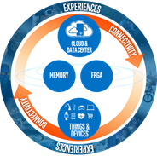
How we will succeed: Strategic partner to the product groups
Strategic partner to product groups in accelerating product development, improving product cost, and schedule predictability
Accelerate product design through critical path project acceleration and deliver >$150M customer biz value
Ratify consolidated product lifecycle management (PLM) and product data management (PDM) strategy
Upgrade and integrate PSG partner portal into Altera.com
Some examples:
Our SoCMax program committed to delivering 40 weeks of critical path product acceleration
We are aligning with cross-Intel stakeholders on a digital data thread starting from idea through product retirement
We just launched the new PSG Sales Enablement Portal, a unified web experience for employees, partners, and suppliers to access transactions, reports, and secure content. Project biz value: $7.5M additional revenue, $500K cost savings
1
Notes:
Clarify the DTG and CQN connections
Get examples on $150M biz value. (Greg)
Annie …
2017 Actions to reach 2020 goals are:
Accelerate product design through critical path project acceleration and deliver customer biz value >$150M (SO1/2)
Develop and deliver Phase 1 Integrated Product Development environment (IPDE) to improve efficiency and on time delivery (SO2)
Develop and deliver Phase 1 master data solution for PEG (SO2)
Deliver FUSE end-to-end tooling solution to PEG to reduce PRTs and MRBs (SO2)
Develop and deploy M&A playbooks (Product Engineering/Org Integration) (SO1)
95% of IT PTS projects aligned to Virtuous Cycle of Growth
Upgrade and integrate PSG partner portal into Altera.com (SO2)
BU engagement model with clear goals and biz value review mechanisms (SO4)
Speaker notes:
Move away from ad hoc requests where we try and prioritize and fit in. We want employees to step back and look at business process between the BU’s that we work with and partner with them to deliver complete solutions of what we need (they might not even know what they need). Ex. Jama for management requirements tool – how does this interface with materials in TMG / traceability?
Each group telling us what’s most important for them is not scalable
CISA transformation a good ex. - what is all the work they are doing; how do we play in the overall strategy
What is the behavior that we want employees to do: Understand how our solutions are integrated; not creating stand a lone solutions. Tied into Dev Ops – makes the work visible. Bring back to the managers how the work is prioritized or when getting requests for new work.
Accelerate product design through critical path project acceleration and deliver customer biz value >$150M (SO1/2)
Develop and deliver Phase 1 Integrated Product Development environment (IPDE) to improve efficiency and on time delivery (SO2)
Develop and deliver Phase 1 master data solution for PEG (SO2)
Deliver FUSE end-to-end tooling solution to PEG to reduce PRTs and MRBs (SO2)
Develop and deploy M&A playbooks (Product Engineering/Org Integration) (SO1)
95% of IT PTS projects aligned to Virtuous Cycle of Growth
Upgrade and integrate PSG partner portal into Altera.com (SO2)
BU engagement model with clear goals and biz value review mechanisms (SO4)

Slide 12
Value Stream
How we will succeed: Improve quality, accelerate product time to market
Solution Group
As part of the IT Operating Model, we plan to organize around the Product Lifecycle Management value stream and its three solution groups: 1. Product Explore & Planning, 2. Product Development, 3. Product Ramp & Production.
Operational Value Stream
Agile Team(s)
Collaboration required for efficient, predictable product development, manufacture and launch
Product Lifecycle Management
Product Explore & Planning
Product Development
Product Ramp & Production
Product Professional Technical Services
Concept to roadmap
Hardware development enablement
Prototype product to production at scale
FLEX solutions
Flexible resourcing solutions
Roadmap to plan
Software development enablement
Engineering change request to fully executed change
Ongoing product lifecycle management
Design workflow enablement
Production quality management
Privacy Office

Slide 13

How we will succeed: OpX and Innovation
Best-in-class innovation and OpX
Foster innovation in products and process
Respond with agility to changing business demand through IT PMO & agile prioritization
Achieve Level 3 maturity in DevOps
Engage / drive focus on privacy (GDPR)
Successful PSG integration, Bundle 2: Phase 1 and 2
Some examples:
iCube innovation and the PES IT Technical Conference 2017
A look inside the IT PMO
Agile/DevOps success stories highlight the PES IT transformation, e.g., 5x velocity increases (Jazz) , >300 hours saved (MyPLM), 47% user increase w/o ticket volume increase (Jira).
Privacy Office GDPR program established to address GDPR readiness
2
Notes:
Drive OpX with passion, vigor and discipline
Landscape simplification (tools and data)
DevOps & ITIL maturity – Make all the work visible to reduce hardship & drudgery

Slide 14

How we will succeed: People are our foundation
Skilled and adaptable workforce with engaged and inspired employees
Focus on career development: career ladders and lattices, technical focus areas (TFAs), tech leadership pipeline (TLP)
Skill up on Agile and DevOps
Embrace diversity and inclusion: hiring and recruiting, lean-in circles, career progression, listening sessions
Connect and engage at the site level: Communities of Practice, GPTW activities, health and safety
Some examples:
New Oregon CoP kick off in October with a focus on Design Thinking
Job codes cleaned up and aligned to emerging industry norms
Vibrant Inside Blue Community where we share stories, engage in conversation
3
Notes:
Sanjeev – roadmap forward where people slot in
Job code / spans levels
Gina - Align to IT / Enterprise level initiatives.
how much can we grow … grade growth?

Slide 15

What’s most important right now (Q4 2017)
Business conditions change rapidly and it’s up to each of us to re-set our priorities to focus on what’s most important right now. Talk to your direct manager to clarify what’s most important for you and your team.
Business partnership
OpX
Strengthen our relationships with key partners in PEG and SSG
Welcome new teams from the business, stay focused, no disruption to committed deliverables
Gain alignment on our PLM strategy
Activate our PMO. Prioritize and fund our top projects for 2018. Track our progress. Adapt.
Reduce our technical debt
Notes:
What’s most important right now? If we accomplish only one thing during the next 3-6 months, what would it be? In other words, what must be true 3-6 months from now for us to be able to look back and say with any credibility that we had a good period?

Slide 16

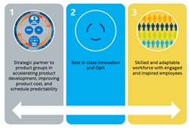
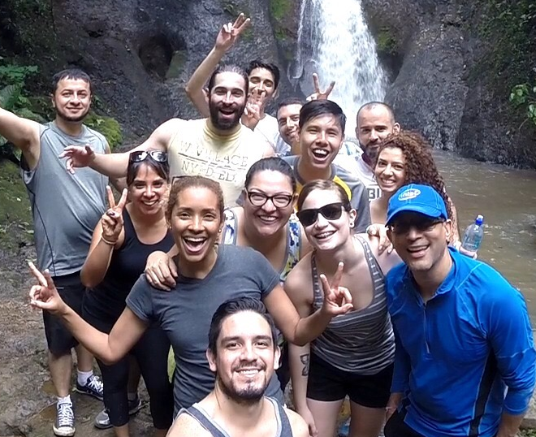
How you can get engaged
Join and follow our Inside Blue Community
Keep up with the latest PES IT updates and join the conversation by commenting with your thoughts and questions
Understand PES IT strategies
Know how your work aligns with and supports our strategies. Talk to your manager if you are not sure how your work aligns.
Participate in local site events
Get to know the PES IT team members at your site. Help us build an engaged and inspired team!

Slide 18
IT Vision: Accelerate Intel’s Growth through Best-in-Class IT Solutions and Services
SO# | Strategic Objectives | Key Initiatives
SO #1 |  | Apply IT innovation, expertise, and proof points of Intel products to create and advance Intel’s business models, solutions and services in the market Unlock the value of M&A faster through standard integration models and processes
SO #2 |  | Enable a data driven decision making culture by delivering foundational capabilities with end to end connected data and analytics services Lead enterprise-wide definition and digital transformation of our end-to-end business processes to increase agility and velocity Deliver insights and solutions to radically improve how Intel designs, manufactures, sells and delivers its products
SO #3 |  | Increase Intel employee productivity by optimizing user experiences for critical end-user IT services Enable Intel employees to seamlessly work from anywhere via any device through easy-to-use, cloud-enabled integrated solutions
SO #4 |  | Drive best-in-class operational performance through mature ITIL adoption, consistent metrics and automation Establish Enterprise PMO to lead a value-driven prioritization process and institute DevOps for all solutions Drive operational productivity and IT portfolio lifecycle management to reduce run costs Simplify IT landscape by establishing and governing enterprise reference architecture aligned to business needs Keep Intel legal and secure and protect IP with robust security, privacy and compliance capabilities
SO #5 |  | Promote employee growth through robust career planning, development opportunities, and investing in leadership through domain knowledge and technical skill development Build leadership depth through management development and succession planning Create a vibrant workforce and plan to ensure we have the right talent and capabilities while incorporating diversity and inclusion in everything we do
Advance intel products and services in the market
Transform how Intel RUNs AND GROWs
INCREASE productivity and enhance user experience of Intel’s workforce
Secure Intel and Deliver opx across ALL IT Services
INSTILL a Culture of Excellence with Engaged and Inspired employees
Updated: Jul 5, 2017
Notes:
Jul 5 update: Changed SO #2 title replacing “Continuously Improve How Intel’s Businesses Run & Grow” to “Transform How Intel Runs and Grows” given Paula T’s request
Jun 2 update- Rearranged SO #4 title, put Secure Intel before Deliver OpX
Mar 28 update- updated some overlooked KI wording changes that IT staff approved mid-Mar

Slide 19
IT Strategic Objectives
PES IT 2020 Vision
PES IT 2017 Priorities
So #1: Advance intel products and services in the market
Accelerate product design through critical path project acceleration and deliver customer biz value >$150M (SO1/2)
Develop and deliver Phase 1 Integrated Product Development environment (IPDE) to improve efficiency and on time delivery (SO2)
Develop and deliver Phase 1 master data solution for PEG (SO2)
Deliver FUSE end-to-end tooling solution to PEG to reduce PRTs and MRBs (SO2)
Develop and deploy M&A playbooks (Product Engineering/Org Integration) (SO1)
95% of IT PTS projects aligned to Virtuous Cycle of Growth
Upgrade and integrate PSG partner portal into Altera.com (SO2)
BU engagement model with clear goals and biz value review mechanisms (SO4)
We are recognized by product development teams and IT as a critical partner in accelerating product development, improving product cost, and schedule predictability
So #2: Continuously improve how INTEL’s BUSINESSES RUN AND GROW
So #3: INCREASE productivity and enhance user experience of Intel’s workforce
Robust multi-year strategy, benchmarking and planning process leading to continuous improvements in BV, BSI, metrics, security, privacy, controls, run vs grow ratio (SO4)
Automated balanced scorecard(s) to manage all PES IT operational indicators (SO4)
Complete readiness for next generation privacy laws (GDPR) (SO4)
Achieve Level 3 maturity in DevOps (SO4)
Establish PTS as center of competency for pay-per-view operations at Intel (SO4)
Successful PSG bundle 2, phase 1 and 2 integration (SO 1)
So #4: Deliver opx across ALL IT Services and secure INTEL
We are best in class for OpX AMB our employees, partners, and Intel
Develop a consistent talent management process & framework encompassing skills demand/forecasting, employee career development, hiring, leadership pipelines AMB by NPS % recommend, career dev plans for all employees (SO5)
Strengthen our culture of innovation by driving adoption of our innovative ideas into our customers’ work (SO5/1)
Engage and inspire our people and build a culture of trust and inclusion (SO5)
So #5 INSTILL a Culture of Excellence with Engaged and Inspired employees
Skilled workforce with engaged and inspired employees
Notes:
Add a summary slide of the accomplishments that we’ve had in the year (could pull the slides from PEG review / the last portfolio review). Business value slide (TTM). Ask each director what the “So what” is for that.

Slide 20
How we will succeed – PLM digital thread end-to-end
Collaboration required for efficient, predictable product development, manufacture and launch
Product Design & Eng’g
Rqmts Management
Integrated BOM & Variant Management
IP Management / Re-Use
Software Development
Mfg Process Planning
Manufacturing BOM and Routing Creation
Fab, Sort, Die Prep, Assy, Test Process Planning
EBOM-MBOM Alignment
Mfg. Effectiveness
Production Execution
Plant Specific Manufacturing BOM
Change Management
Manufacturing Quality Compliance
Supplier Management & Collaboration
Product Support
Closed Loop Feedback to Product Design / Engineering
Service BOM Management
Product Data Reporting & Analytics
PDM
Platform
“Digital Thread”
Suppliers
Re-use of “old” IP, inability to assess compliance with FuSA requirements
Lack of effective mgmt or centralized control of IP limits effective re-use
Disconnected requirements limit traceability & predictability
Tiling and high variance product complexity cause explosion of manufacturing / assembly / test planning items due to current manual LRP / MRP / Shop Floor item create processes
No integrated Product BOM (IP, MFG, SW BOM) causing BOM inaccuracy and E2E inefficiency
Inadequate BOM costing process highlights disconnect between marketing, design & manufacturing
Limited E2E product data reporting and analytics capability
No systematic product data feedback loop for customer / field issues
Our challenges
Notes:
Our piece is front half and the framework

Slide 21
PES IT Teams/Portfolios
As of September 2017

Slide 22







Product Data Solutions (PDS) – 120 Employees
Service delivery via two primary reference architectures:
1
SPEED
Systems, Components, Product Engineering and ECO Database
2
iBI / OnTrak
“The ability of one’s self to do BI”
Vision: “We are the business information that accelerates Intel’s platform and product delivery”
Mission: To deliver integrated data foundations, analytics, and product data services across the entire Product Lifecycle
Product Data Management (PDM)
Product data foundation spanning the entire Product Lifecycle
Product Quality
Protecting the Intel brand through issue and excursion management
= PEG, TMG
= TMG
SPEED
= 58, Outsource
SPEED
= 15, PPV
Product Ecology
Keeping Intel compliant across the globe
Product Data Analytics (PDA)
Design data & workflow for product development
= TMG
= PEG
SPEED
= 3, Outsource
iBI
= 44, PPV
Notes:
Product Data Management: Product data foundation spanning entire Product Lifecycle
Systematically aggregated product data from the business process flow starting with Design, through Manufacturing, and out to Sales & Marketing required to build and ship all Intel products
Product Quality: Protecting the Intel brand through Issue/Excursion Management
A common Manufacturing Issue Management ecosystem with data quality necessary to ramp wafers and prevent excursions
Environmental Compliance: Keeping Intel compliant across the globe
Capabilities that ensure products sold/distributed by Intel are safe and comply with world-wide product regulations
Product Data Analytics: Design data and workflow foundation for Product Development
Application suite that delivers data services and product analytics to boost Product TTM, increases Intel’s revenue and drives cost savings
CPLG = Customer Fulfillment, Planning & Logistics

Slide 23
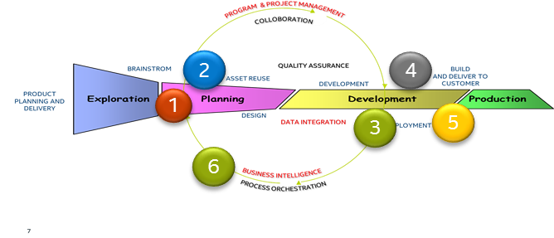
Product Lifecycle Solutions (PLCS) PLCS provides reliable and cost effective integrated PLC solutions that enable accelerated product development for every Intel business
SERVICES:
Workflow/Issue and Defect Management - Solutions to manage projects/workflows and track product defects
Requirements Management - Solutions to manage product requirements
Software Developers Service Solutions to manage Source Code, Code Scanning, and automated Build and Release.
IP Management - Solutions to manage Intel Intellectual Property
Globalization and Localization (GLS) - Solutions to Localize, translate, and internationalize Intel software.
Data and Integration - Integrated Solutions across each of the ALM services. Includes Master Data Hub and Analytics.
OPERATIONS: 97 employees, 3 Geographies (US, Costa Rica, India)
CUSTOM ERS: Intel Product Developers (software and silicon) in ALL Intel Business Units
KEY INITIATIVE:
Integrated ALM is a software shift-left enabling program that reduces product TTM, improves product quality, and improves efficiency all along Intel’s Product Lifecycle.
Sharepoint: https://sharepoint.amr.ith.intel.com/sites/ITS3_Software/SitePages/Home.aspx
InsideBlue: https://soco.intel.com/groups/plcs

Slide 24



IT Professional Technical Services (IT PTS)
Vision: Premier IT Professional Technical Services influence and accelerate Intel's business
Mission: We make it easier to move faster on the things that matter most!
Services
Flex Services
Develops and delivers optimized burst capacity solutions to enable Intel to move faster
Enterprise Process Excellence (PEx)
Achieves efficiency and effectiveness improvements using industry-proven tools and methodologies
Contingent Workforce Solutions
(CWS) Optimizes processes, performance and cost through consolidated outsourcing
For more information:
Inside Blue: IT Professional Technical Services
Website here
Number of employees: 227 (majority PPV)
Key Initiatives:
Fully support Intel and Product Groups through 95% of engagements aligned to the Intel VCOG Strategy
PTS as Intel’s PPV Center of Excellence
Showcase Intel’s technologies with measurable $ revenue uplift
Establish CWS validation capabilities outsourced at Intel.
Expand PEx service offerings to better drive business transformations

Slide 25
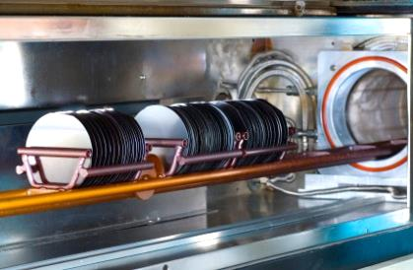
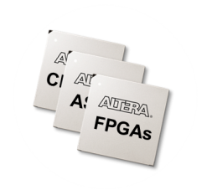
Programmable Solutions Group IT (PSG IT)
Make the PSG business unit thrive
Services:
IT Infrastructure, Enterprise Applications, Business Systems Analysis
Employees: 100+
Key Initiatives:
Intel / PSG Integration
PICE: PSG Intel Compliant Environment
SEP: Sales Enablement Portal
SPRINT (Supply Chain) Center of Excellence
http://it.altera.com/Pages/index.aspx

Slide 26

Privacy Office Keep the trust as Intel shifts to new data intensive markets
Services:
Privacy Office and Privacy Governance
Employees: 17
Key Initiatives:
GDPR readiness
Develop privacy consciousness & business acumen
Automate and streamline; focus on high risk

